Slide 1
ONLINE CLOTHING DATABASE MANAGEMENT SYSTEM

Slide 2
Team_Member_1 :
Name : S. Trishul tejus
Class : CSE Sec_A
Roll.No : 21CSB0A57
E-Mail Id : st21csb0a57@student.nitw.ac.in
Team_Member_2 :
Name : K. Shashidhar
Class : CSE Sec_A
Roll.No : 21CSB0A32
E-Mail ID : ks21csb0a32@student.nitw.ac.in

Slide 3
. PROBLEM STATEMENT :
The major theme of the project is to design a database for the online clothing to manage the orders in the websites like Ajio and placing all the orders and payments to and from the customers.

Slide 4
DESCRIPTION :
Customer:
This entity represents a customer who purchases products from the online clothing store.
Attributes: customer_id (primary key), first_name, last_name, email, password.
Primary key: customer_id.
Product:
This entity represents a product that is sold by the online clothing store.
Attributes: product_id (primary key), name, price, description, category_id (foreign key), brand_id (foreign key), size_id (foreign key), color_id (foreign key), material_id (foreign key), discount_id (foreign key).
Primary key: product_id.
Foreign keys: category_id, brand_id, size_id, color_id, material_id, discount_id.

Slide 5
Category:
This entity represents a category that a product can belong to.
Attributes: category_id (primary key), name, description.
Primary key: category_id.
Brand:
This entity represents a brand that a product can belong to.
Attributes: brand_id (primary key), name.
Primary key: brand_id.
Size:
This entity represents a size that a product can come in.
Attributes: size_id (primary key), name.
Primary key: size_id.

Slide 6
Order:
This entity represents an order that a customer has placed for one or more products.
Attributes: order_id (primary key), customer_id (foreign key), order_date, total_price, shipping_address_id (foreign key), billing_address_id (foreign key), payment_id (foreign key).
Primary key: order_id.
Foreign keys: customer_id, shipping_address_id, billing_address_id, payment_id.
Order Item:
This entity represents an item that is part of an order.
Attributes: order_id (foreign key), product_id (foreign key), quantity.
Foreign keys: order_id, product_id.
Payment:
This entity represents a payment that a customer has made for an order.
Attributes: payment_id (primary key), amount, status, method, date, customer_id (foreign key).
Primary key: payment_id.
Foreign key: customer_id.

Slide 7
Shipping Address:
This entity represents a shipping address for an order.
Attributes: address_id (primary key), street, city, state, zip_code, country.
Primary key: address_id.
Billing Address:
This entity represents a billing address for an order.
Attributes: address_id (primary key), street, city, state, zip_code, country.
Primary key: address_id.
Color:
This entity represents a color that a product can come in.
Attributes: color_id (primary key), name.
Primary key: color_id.

Slide 8
Material:
This entity represents a material that a product can be made of.
Attributes: material_id (primary key), name, description.
Primary key: material_id.
Discount:
This entity represents a discount that can be applied to a product.
Attributes: discount_id (primary key), name, amount.
Primary key: discount_id.

Slide 9
FUNCTIONAL DEPENDENCIES FOR THE RELATIONS :
Customer:
customer_id → first_name, last_name, email, password
Product:
product_id → name, price, description, category_id, brand_id, size_id, color_id, material_id, discount_id
category_id → name, description
brand_id → name
size_id → name
color_id → name
material_id → name, description
discount_id → name, amount
Category:
category_id → name, description

Slide 10
Brand:
brand_id → name
Order:
order_id → customer_id, order_date, total_price, shipping_address_id, billing_address_id, payment_id
customer_id → first_name, last_name, email
shipping_address_id → street, city, state, zip_code, country
billing_address_id → street, city, state, zip_code, country
payment_id → amount, status, method, date
Order Item:
(order_id, product_id) → quantity
Payment:
payment_id → amount, status, method, date, customer_id
customer_id → first_name, last_name, email

Slide 11
Shipping Address:
address_id → street, city, state, zip_code, country
Billing Address:
address_id → street, city, state, zip_code, country
Size:
size_id → name
Color:
color_id → name
Material:
material_id → name, description
Discount:
discount_id → name, amount
Note: The functional dependencies for each entity are based on the assumption that each attribute is functionally dependent on the primary key of the entity.

Slide 12
FLOW OF PROCESS IN ONLINE CLOTHING DATABASE :
A customer creates an account on the website by providing their name, email address, and password.
The customer browses through the website and adds products to their shopping cart.
When the customer is ready to checkout, they provide their shipping and billing addresses, select a payment method, and confirm their order.
The system processes the payment and sends a confirmation email to the customer.
The customer can leave a review for the purchased product(s) on the website.
The system updates the inventory levels for the purchased product(s).
The system generates reports on sales, inventory levels, and customer reviews for the store owner to review.
The store owner can add new products, update prices, and manage the website content through an administrative dashboard.

Slide 13
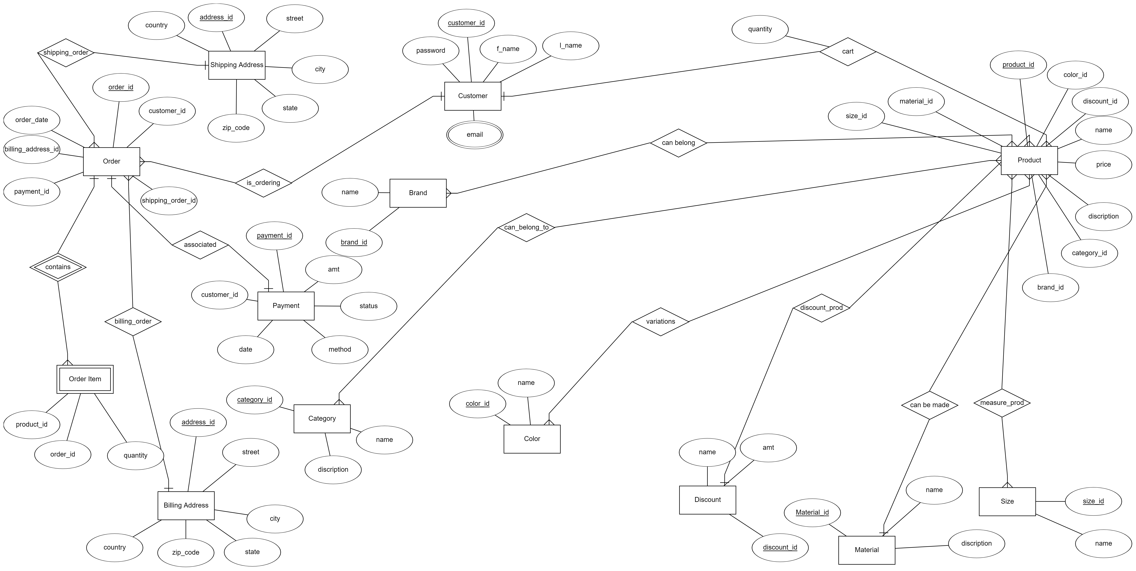
ER DIAGRAM :

Slide 14
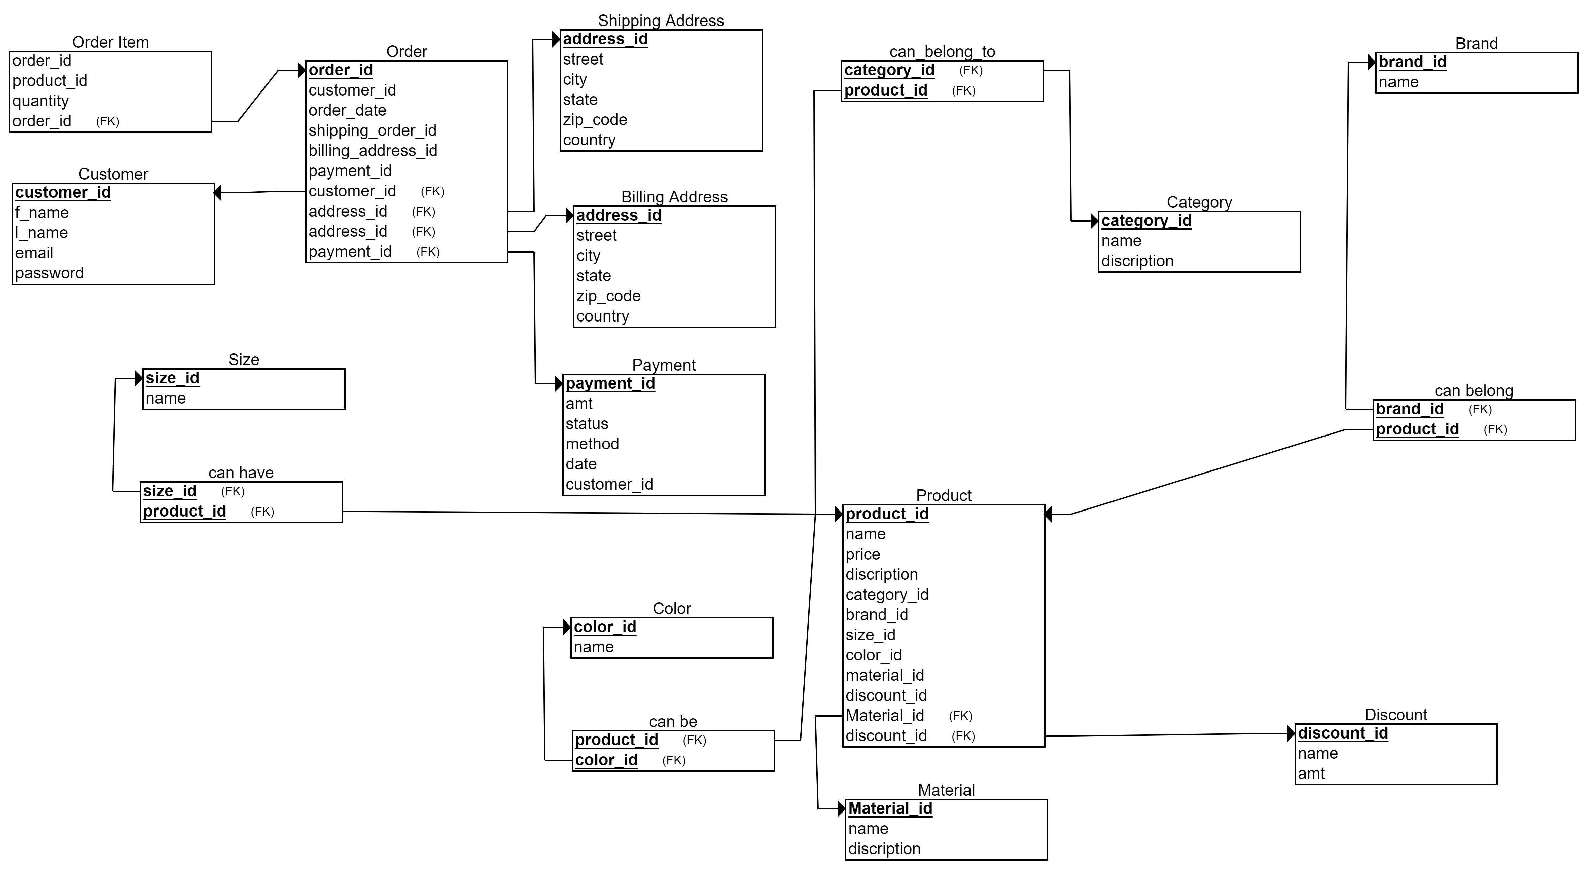
RELATIONAL SCHEMA

Slide 15
ENTITIES AND RELATIONS IN THE SCHEMA :
ENTITIES RELATIONS
Customer shipping_order
Product is_ordering
Category contains
Brand billing_order
Order can_belong_to
Order Item variations
Payment discount_prod
Shipping Address can be made
Billing Address measure_prod
Size can belong
Color associated
Material cart
Discount

Slide 16
CREATION OF TABLES IN THE ORACLE :
-- Customers table
drop table Customers
CREATE TABLE Customers (
customer_id INT PRIMARY KEY,
first_name VARCHAR(50),
last_name VARCHAR(50),
email VARCHAR(100),
password VARCHAR(100));
--Category
CREATE TABLE Category (
category_id INT PRIMARY KEY,
name VARCHAR(100),
description VARCHAR(500)
);
--Brand table
CREATE TABLE Brand (
brand_id INT PRIMARY KEY,
name VARCHAR(100)
);

Slide 17
--Products
CREATE TABLE Products(
product_id INT PRIMARY KEY,
namee VARCHAR(100),
pricee DECIMAL(10,2),
description VARCHAR(500),
category_id INT,
brand_id INT,
size_id INT,
color_id INT,
material_id INT,
discount_id INT,
FOREIGN KEY (category_id) REFERENCES Category(category_id),
FOREIGN KEY (brand_id) REFERENCES Brand(brand_id),
FOREIGN KEY (size_id) REFERENCES Sizee(size_id),
FOREIGN KEY (color_id) REFERENCES Color(color_id),
FOREIGN KEY (material_id) REFERENCES Material(material_id),
FOREIGN KEY (discount_id) REFERENCES Discount(discount_id)
);

Slide 18
-- Order table
CREATE TABLE Orderr (
order_id INT PRIMARY KEY,
customer_id INT,
order_date DATE,
total_price DECIMAL(10,2),
shipping_address_id INT,
billing_address_id INT,
payment_id INT,
FOREIGN KEY (customer_id) REFERENCES Customers(customer_id),
FOREIGN KEY (shipping_address_id) REFERENCES ShippingAddress(address_id),
FOREIGN KEY (billing_address_id) REFERENCES BillingAddress(address_id),
FOREIGN KEY (payment_id) REFERENCES Payment(payment_id));

Slide 19
-- OrderItem table
CREATE TABLE OrderItem (
order_id INT,
product_id INT,
quantity INT,
PRIMARY KEY (order_id, product_id),
FOREIGN KEY (order_id) REFERENCES Orderr(order_id),
FOREIGN KEY (product_id) REFERENCES Products(product_id)
);
-- Payment table
CREATE TABLE Payment (
payment_id INT PRIMARY KEY,
amount DECIMAL(10,2),
status VARCHAR(50),
methodd VARCHAR(50),
datee DATE,
customer_id INT,
FOREIGN KEY (customer_id) REFERENCES Customers(customer_id)
);

Slide 20
--Shippingaddress
CREATE TABLE ShippingAddress (
address_id INT PRIMARY KEY,
street VARCHAR(100),
city VARCHAR(50),
state VARCHAR(50),
zip_code VARCHAR(20),
country VARCHAR(50));
-- Color table
CREATE TABLE Color (
color_id INT PRIMARY KEY,
name VARCHAR(50)
);
-- BillingAddress table
CREATE TABLE BillingAddress (
address_id INT PRIMARY KEY,
street VARCHAR(100),
city VARCHAR(50),
state VARCHAR(50),
zip_code VARCHAR(20),
country VARCHAR(50)
);
-- Size table
select * from billingaddress
select * from sizee;
CREATE TABLE Sizee (
size_id INT PRIMARY KEY,
name VARCHAR(50)
);

Slide 21
-- Material table
CREATE TABLE Material (
material_id INT PRIMARY KEY,
name VARCHAR(50),
description VARCHAR(500)
);
-- Discount table
CREATE TABLE Discount (
discount_id INT PRIMARY KEY,
name VARCHAR(100),
amount DECIMAL(5,2)
);

Slide 22
create table variations(
product_id primary key,
color_id primary key,
FOREIGN KEY (product_id) REFERENCES Product(product_id),
FOREIGN KEY (color_id) REFERENCES Color(color_id)
);
create table measure_prod(
product_id primary key,
size_id primary key,
FOREIGN KEY (product_id) REFERENCES Product(product_id),
FOREIGN KEY (size_id) REFERENCES Size(size_id) );
Tables for relations >
create table can_belong(
product_id primary key,
brand_id primary key,
FOREIGN KEY (product_id) REFERENCES Product(product_id),
FOREIGN KEY (brand_id) REFERENCES Brand(Brand_id)
);
create table can_belong_to(
product_id primary key,
category_id primary key,
FOREIGN KEY (product_id) REFERENCES Product(product_id),
FOREIGN KEY (category_id) REFERENCES Category(category_id) );

Slide 23
Insertions into the table
INSERT INTO Customers values(1, 'Trishul', 'tejus', 'tritej@gmail.com', 'password123');
INSERT INTO Customers values(2, 'Sai', 'charan', 'saicharan@gmail.com', 'password456');
INSERT INTO Customers values(3, 'Manoj', 'harsha', 'manojh@gmail.com', 'password789');
INSERT INTO Customers values(4, 'Supraj', 'pulluru', 'suprajpul@gmail.com', 'passwordabc');
INSERT INTO Customers values(5, 'siddarth', 'nath', 'sidnath@gmail.com', 'passworddef’);
INSERT INTO Products VALUES (1, 'T-Shirt', 20.00, 'A comfortable cotton T-Shirt', 1, 1, 1, 1, 1, 1);
INSERT INTO Products values(2, 'Sneakers', 80.00, 'A pair of running shoes', 2, 2, 2, 2, 2, 2);
INSERT INTO Products values(3, 'Jeans', 60.00, 'A pair of classic denim jeans', 1, 3, 3, 3, 3, 3);
INSERT INTO Products values(4, 'Dress', 100.00, 'A formal evening dress', 4, 4, 4, 4, 4, 4);
INSERT INTO Products values(5, 'Watch', 150.00, 'A stainless steel wristwatch', 5, 5, 5, 5, 5, 5);

Slide 24
INSERT INTO Category (category_id, name, description) VALUES(1, 'Clothing', 'Apparel and accessories for men and women');
INSERT INTO Category (category_id, name, description) VALUES(2, 'Shoes', 'Footwear for men and women');
INSERT INTO Category (category_id, name, description) VALUES(3, 'Accessories', 'Watches, jewelry, and other fashion accessories');
INSERT INTO Category (category_id, name, description) VALUES(4, 'Dresses', 'Formal and casual dresses for women');
INSERT INTO Category (category_id, name, description) VALUES(5, 'Watches', 'Analog and digital wristwatches for men and women’);
INSERT INTO Brand values(1, 'Nike');
INSERT INTO Brand values(2, 'Adidas');
INSERT INTO Brand values(3, 'Levi Strauss');
INSERT INTO Brand values(4, 'Calvin Klein');
INSERT INTO Brand values(5, 'Rolex');

Slide 25
insert into orderr values(1, 1, '25-04-2022', 250.00, 1, 2, 1);
insert into orderr values(2, 2, '02-05-2022', 125.50, 3, 3, 2);
insert into orderr values(3, 3, '05-03-2022', 75.00, 5, 5, 3);
insert into orderr values(4, 4, '05-04-2022', 200.00, 4, 4, 4);
insert into orderr values(5, 5, '05-05-2022', 350.00, 2, 2, 5);
INSERT INTO OrderItem VALUES(1, 1, 2);
INSERT INTO OrderItem VALUES(1, 2, 1);
INSERT INTO OrderItem VALUES(2, 3, 3);
INSERT INTO OrderItem VALUES(3, 4, 1);
INSERT INTO OrderItem VALUES(3, 5, 2);

Slide 26
-INSERT INTO shippingAddress (address_id, street, city, state, zip_code, country) VALUES (1, 'fathimanagar', 'hanmakonda', 'telangana', '500037', 'India');
INSERT INTO shippingAddress VALUES (2, 'housingboard', 'hyderabad', 'telangana', '500038', 'India');
INSERT INTO shippingAddress VALUES(3, 'patelnagar', 'surat', 'gujarath', '500467', 'India');
INSERT INTO shippingAddress VALUES(4, '101 Washington St', 'Boston', 'MA', '02102', 'USA');
INSERT INTO shippingAddress VALUES(5, 'Market St', 'kasargud', 'kerala', '500123', 'India');
INSERT INTO BillingAddress (address_id, street, city, state, zip_code, country) VALUES (1, 'fathimanagar', 'hanmakonda', 'telangana', '500037', 'India');
INSERT INTO BillingAddress VALUES (2, 'housingboard', 'hyderabad', 'telangana', '500038', 'India');
INSERT INTO BillingAddress VALUES(3, 'patelnagar', 'surat', 'gujarath', '500467', 'India');
INSERT INTO BillingAddress VALUES(4, '101 Washington St', 'Boston', 'MA', '02102', 'USA');
INSERT INTO BillingAddress VALUES(5, 'Market St', 'kasargud', 'kerala', '500123', 'India');
delete from billingaddress where address_id<>0;

Slide 27
INSERT INTO Payment(payment_id, amount, status, methodd, datee, customer_id) VALUES (1, 99, 'PAID', 'Creditcard', '01-01-2022', 1);
INSERT INTO Payment VALUES(2, 149.99, 'PAID', 'PayPal', '01-02-2022', 2);
INSERT INTO Payment VALUES(3, 199.99, 'PENDING', 'Bank Transfer', '01-03-2022', 3);
INSERT INTO Payment VALUES(4, 299.99, 'PAID', 'Credit Card', '01-04-2022', 4);
INSERT INTO Payment VALUES(5, 99.99, 'PAID', 'Credit Card', '01-05-2022', 5);
INSERT INTO Sizee (size_id, name) VALUES (1, 'Small');
INSERT INTO Sizee (size_id, name) VALUES(2, 'Medium');
INSERT INTO Sizee (size_id, name) VALUES(3, 'Large');
INSERT INTO Sizee (size_id, name) VALUES(4, 'XL');
INSERT INTO Sizee (size_id, name) VALUES(5, 'XXL');

Slide 28
INSERT INTO Color (color_id, name) VALUES (1, 'Red');
INSERT INTO Color (color_id, name) VALUES (2, 'Blue');
INSERT INTO Color (color_id, name) VALUES (3, 'Green');
INSERT INTO Color (color_id, name) VALUES (4, 'Yellow');
INSERT INTO Color (color_id, name) VALUES (5, 'Black’);
INSERT INTO Material (material_id, name, description) VALUES (1, 'Cotton', 'Soft and breathable fabric');
INSERT INTO Material (material_id, name, description) VALUES (2, 'Polyester', 'Durable and quick-drying fabric');
INSERT INTO Material (material_id, name, description) VALUES (3, 'Wool', 'Warm and insulating fabric');
INSERT INTO Material (material_id, name, description) VALUES (4, 'Leather', 'Strong and flexible material');
INSERT INTO Material (material_id, name, description) VALUES (5, 'Denim', 'Sturdy and versatile fabric');

Slide 29
INSERT INTO Discount (discount_id, name, amount) VALUES (1, 'Summer Sale', 0.20);
INSERT INTO Discount (discount_id, name, amount) VALUES(2, 'Black Friday', 0.30);
INSERT INTO Discount (discount_id, name, amount) VALUES(3, 'Holiday Season', 0.25);
INSERT INTO Discount (discount_id, name, amount) VALUES(4, 'New Year', 0.15);
INSERT INTO Discount (discount_id, name, amount) VALUES(5, 'Clearance', 0.50);

Slide 30
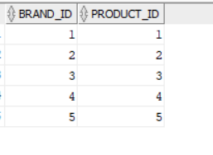
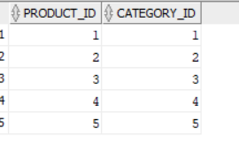
RELATIONS INSERTED VALUES :
insert into can_belong values(1,1);
insert into can_belong values(2,2);
insert into can_belong values(3,3);
insert into can_belong values(4,4);
insert into can_belong values(5,5);
insert into can_belong_to values(1,1);
insert into can_belong_to values(2,2);
insert into can_belong_to values(3,3);
insert into can_belong_to values(4,4);
insert into can_belong_to values(5,5);

Slide 31
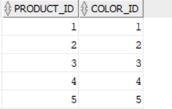
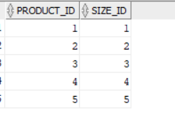
insert into variations values(1,1);
insert into variations values(2,2);
insert into variations values(3,3);
insert into variations values(4,4);
insert into variations values(5,5);
insert into measure_prod values(1,1);
insert into measure_prod values(2,2);
insert into measure_prod values(3,3);
insert into measure_prod values(4,4);
insert into measure_prod values(5,5);

Slide 32
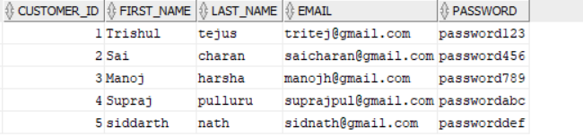
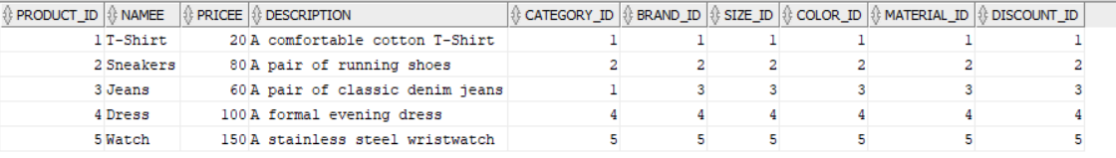
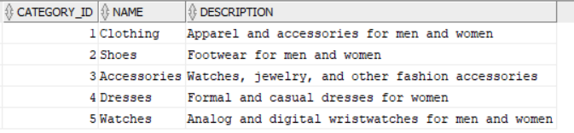
Relational tables Customer : Product : Category :

Slide 33
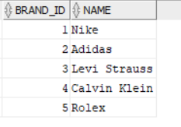
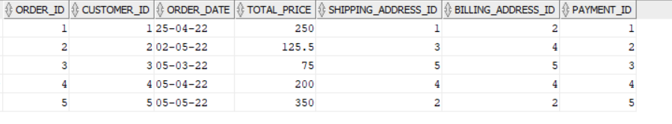
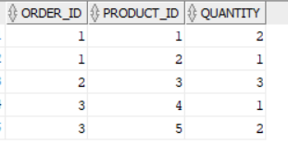
Brand :
Orderr :
Orderitem :

Slide 34
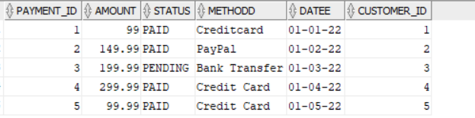
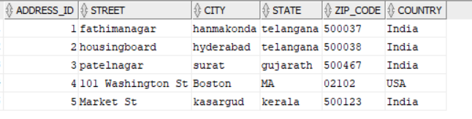
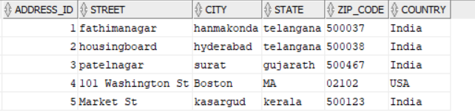
Payment :
Shippingaddress :
BillingAddress :

Slide 35
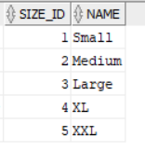
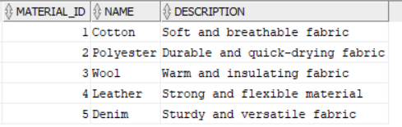
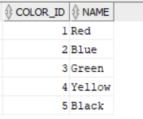
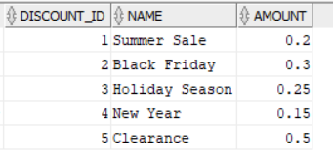
Size : Material :
Color : Discount :

Slide 36
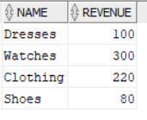
Queries :
Query1 :
What is the total revenue generated from each category of products?
SELECT Category.name, SUM(OrderItem.quantity * Products.pricee) as revenue
FROM OrderItem
JOIN Products ON OrderItem.product_id = Products.product_id
JOIN Category ON Products.category_id = Category.category_id
GROUP BY Category.name;

Slide 37
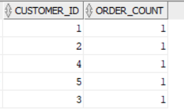
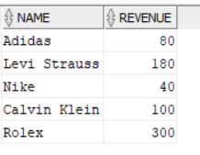
Query2 :
What is the total number of orders placed by each customer?
SELECT customer_id, COUNT(*) as order_count FROM Orderr GROUP BY customer_id;
Query3 :
What is the total revenue generated by each brand of products?
SELECT Brand.name, SUM(OrderItem.quantity * Products.pricee) as revenue
FROM OrderItem
JOIN Products ON OrderItem.product_id = Products.product_id
JOIN Brand ON Products.brand_id = Brand.brand_id
GROUP BY Brand.name;

Slide 38
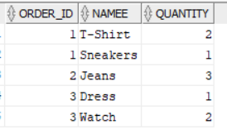
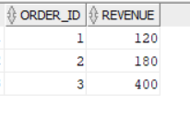
Query4
What are the names and quantities of all products ordered in each order?
SELECT Orderr.order_id, Products.namee, OrderItem.quantity
FROM Orderr
JOIN OrderItem ON Orderr.order_id = OrderItem.order_id
JOIN Products ON OrderItem.product_id = Products.product_id;
Query5 :
What is the total revenue generated by each order?
SELECT Orderr.order_id, SUM(Products.pricee * OrderItem.quantity) AS revenue
FROM Orderr
JOIN OrderItem ON Orderr.order_id = OrderItem.order_id
JOIN Products ON OrderItem.product_id = Products.product_id
GROUP BY Orderr.order_id;

Slide 39
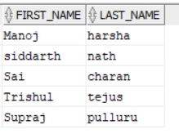
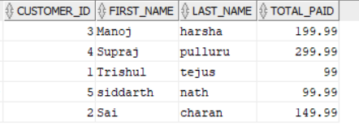
Query6)
Retrieve the names of all customers who have placed an order:
SELECT DISTINCT c.first_name, c.last_name FROM Customers c
JOIN Orderr o ON c.customer_id = o.customer_id;
Query7)
Retrieve the total amount paid by each customer:
SELECT c.customer_id, c.first_name, c.last_name, SUM(p.amount) AS total_paid
FROM Customers c
JOIN Payment p ON c.customer_id = p.customer_id
GROUP BY c.customer_id, c.first_name, c.last_name;

Slide 40
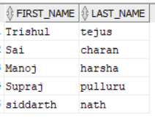
Query8)
Retrieve the names of all customers who have placed an order:
SELECT c.first_name, c.last_name
FROM Customers c
LEFT JOIN Orderr o ON c.customer_id = o.customer_id
WHERE o.order_id IS not NULL;

